Slide 1
Deep Learning_11주차
Department of Data Science
Hyun seok Lee

Slide 2
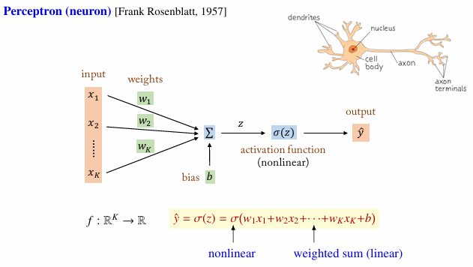
0. Perceptron

Slide 3
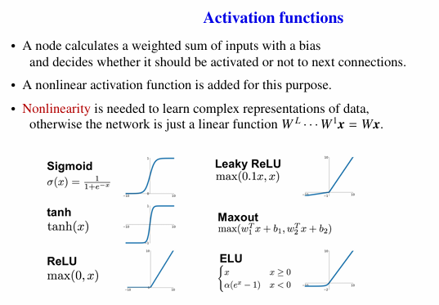
1. Activation functions
z
(Exponential linear unit)

Slide 4
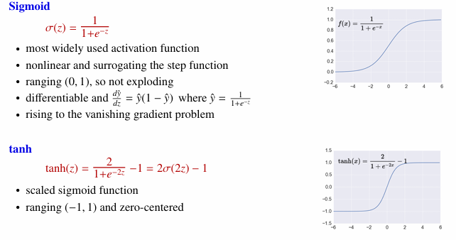
1. Activation functions

Slide 5
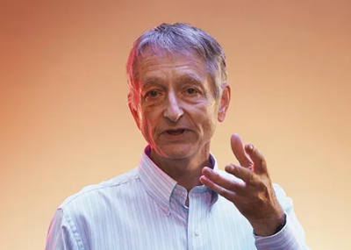
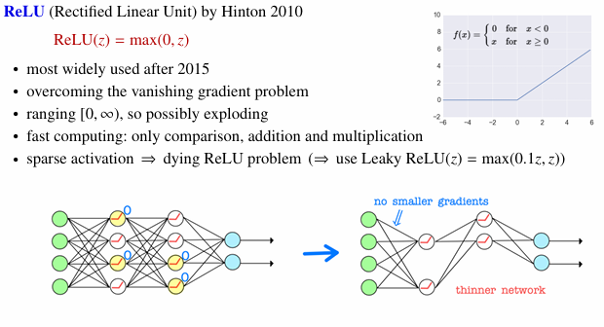
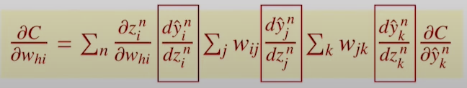

1. Activation functions
Dropout -> model averaging
h
i
j
k

Slide 6
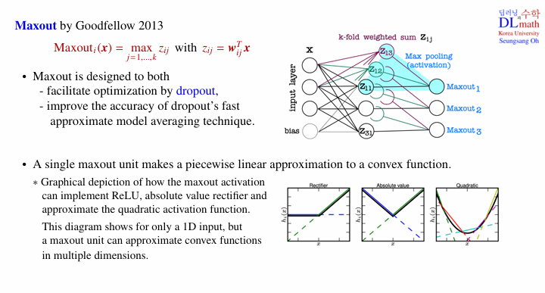

1. Activation functions
i

Slide 7
감사합니다
Thank you

